Slide 1
HDSB EQAO HIGHLIGHTS
2015 - 2016

Slide 2
EQAO Results Overview
Grade 3 | Reading | Writing | Math
HDSB | 79 | 78 | 70
Province | 72 | 74 | 63
Grade 9 Math | Applied Course | Academic Course
HDSB | 55 | 90
Province | 45 | 83
Grade 6 | Reading | Writing | Math
HDSB | 85 | 85 | 56
Province | 81 | 80 | 50
OSSLT | Achievement Results for Fully Participating First-Time Eligible Students | Achievement Results for Fully Participating, Previously Eligible Students
HDSB | 88 | 62
Province | 81 | 49
Notes:
DB

Slide 3
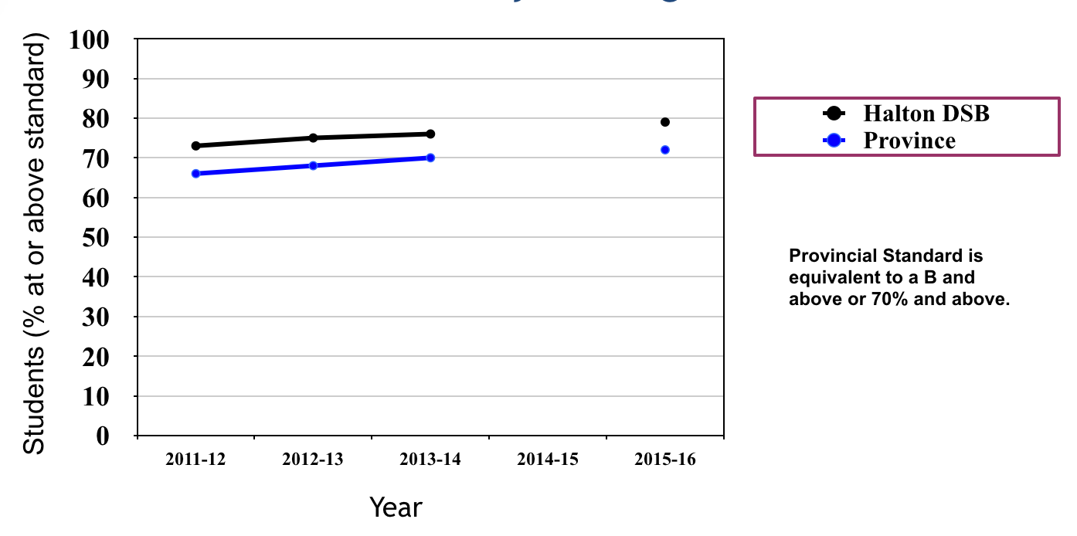
Noteworthy…
Grade 3 Reading at highest level ever!
PRIMARY READING
Notes:
DB

Slide 4
Noteworthy…
Results are sustained for
Gr. 9 Math and Ontario Literacy Test
“Best ever” results for
Gr. 3 Reading and Gr. 6 Writing
HDSB above the Province in ALL Assessments!
Achievement gaps do not exist for English Language Learners
Applied Math achievement continues to be a focus for improvement
Junior math continues to decline for HDSB and the Province
Notes:
DB

Slide 5
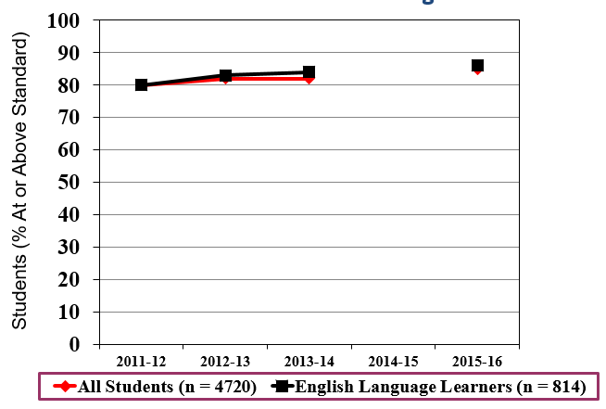
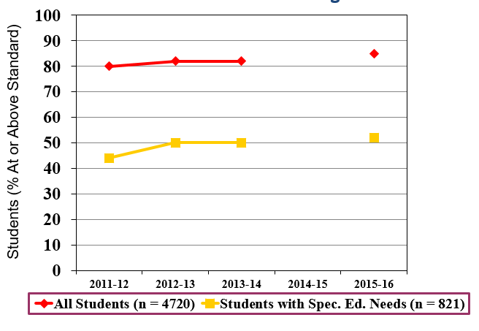
Noteworthy…
Junior Writing
Junior Writing
Notes:
DB

Slide 6
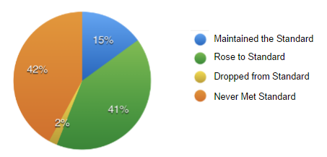
COHORT ANALYSIS We use this to track the same group of students over time.
Noteworthy…
Grade 9 Applied Math From Grade 6 in 2012-13 to Grade 9 in 2015-16
Significant value added (39%) from
Gr. 6 to Gr. 9 Math
Notes:
JHG

Slide 7
Cohort Analysis
We will continue to implement our HDSB Math Plan
Notes:
JHG

Slide 8
Comparison Data: Elementary
EQAO Assessment | 2015-2016 Board (Comparison to 2013-2014) | 2015-2016 Province (Comparison to 2013-2014) | Comparison to Province
Gr. 3 Reading | 79% (+3%) | 72% (+2%) | +7%
Gr. 3 Writing | 78% (-3%) | 74% (-4%) | +4%
Gr. 3 Mathematics | 70% (-4%) | 63% (-4%) | +7%
Gr. 6 Reading | 85% (0%) | 81% (+2%) | +4%
Gr. 6 Writing | 85% (+3%) | 80% (+2%) | +5%
Gr. 6 Mathematics | 56% (-3%) | 50% (-4%) | +6%
Notes:
CS

Slide 9
Comparison Data: Secondary
EQAO Assessment | 2015-2016 Board (Comparison to 2014-2015) | 2015-2016 Provincial Results | Comparison to Province
Gr. 9 Applied Mathematics | 55% (+1%) | 45% | +10%
Gr. 9 Academic Mathematics | 90% (0%) | 83% | +7%
Ontario Literacy Test (first time eligible) | 85% (0%) | 81% | +4%
Notes:
JHG

Slide 10
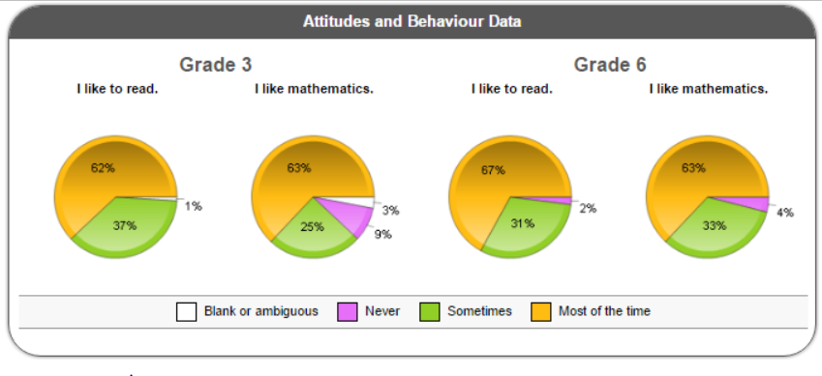
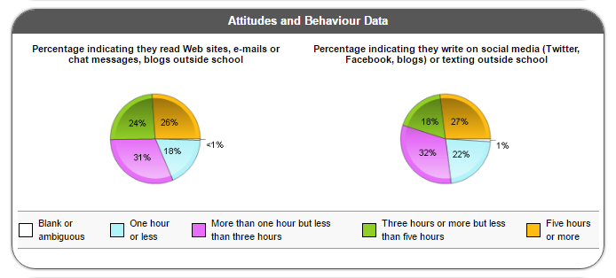
Student Perceptions
Attitudinal and Behavioural Data provides valuable “student voice”
New
Notes:
CS

Slide 11
Literacy Plan
“Best ever” results for Gr. 3 Reading and Gr. 6 Writing
Our plan to meet our goal includes:
Levelled Literacy Intervention in every elementary school
System level professional development
School-based monitoring meetings
Staff resources (e.g., Learning Resource Teachers)
Resulting in continued growth over time
Every Kindergarten to Grade 3 student will receive intensive guided instruction in reading. Students who do not demonstrate movement towards their grade level target, will be assessed and supported by a second tier of support. Source: HDSB Multi-Year Plan 2012-2016
Notes:
CS

Slide 12
Mathematics Plan
HDSB Math Plan in place (year three)
Ministry “Renewed Math Strategy” (year one)
Focus:
Build on successes in literacy
Math lead in every elementary school
Resources in every school (including intervention)
Board sponsored Additional Qualifications
System, school and classroom professional learning
Intentional learning for students with learning disabilities K-12
Applied Learning Strategy in secondary schools
Notes:
CS

Slide 13
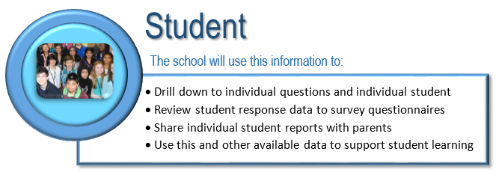
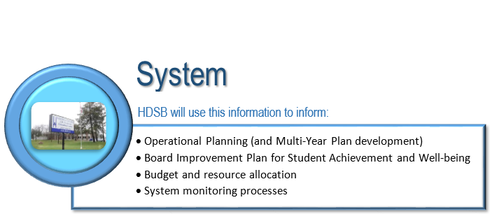
How do we use this information?
Notes:
JHG

