Slide 1
Public Information Meeting Milton #10 Public School
Tuesday, January 9, 2018
7:00 pm
Boyne Public School - Gymnasium

Slide 2
AGENDA
7:00 PM Information Presentation
Welcome, Introductions and Purpose of Meeting
Boundary Review Process
Role of the Boundary Review Committee
Presentation of Selected Scenarios Feedback process
Next steps and timeline for decision
Adjournment
7:30 PM Feedback
‹#›

Slide 3
Introductions
Milton Trustees Kim Graves and Donna Danielli
Halton District School Board Staff
Director Stuart Miller
Principal of Milton #10 Public School
Gavin Robertson
Boundary Review Committee Members
Boundary Review Steering Committee

Slide 4
Boundary Review Steering Committee
Family of Schools Superintendent of affected areas
Jacqueline Newton - Chair of BRSC
Superintendent of Program
Cristina Salmina
Superintendent of Business
Lucy Veerman
Manager from Planning Department
Dom Renzella (Manager)
Michelle D’Aguiar
Mitchell Gundy
Trustees for the affected areas
Trustee Kim Graves
Boundary Review Committee Chairs (appointed by Director and Chair of the Board)
Superintendent of Student Services
Trustee Donna Danielli (Co-Chair of BRC)
Gord Truffen (Co-Chair of BRC)
Mark Zonneveld
Notes:
Introduce

Slide 5
Purpose of Meeting
To share information about the boundary review process for Milton #10 Public School
To review scenarios and the proposed boundaries
To provide members of the public with an opportunity to provide feedback on the scenarios
‹#›

Slide 6
Why A Boundary Review?
At the September 20, 2017 Board meeting, HDSB Trustees approved a motion to initiate the process to establish a boundary for Milton #10 Public School:
“Be it resolved that the Halton District School Board direct the Director to
undertake a school boundary review for the new Milton #10 Public School, with an expected completion date of no later than February 2018.”

Slide 7
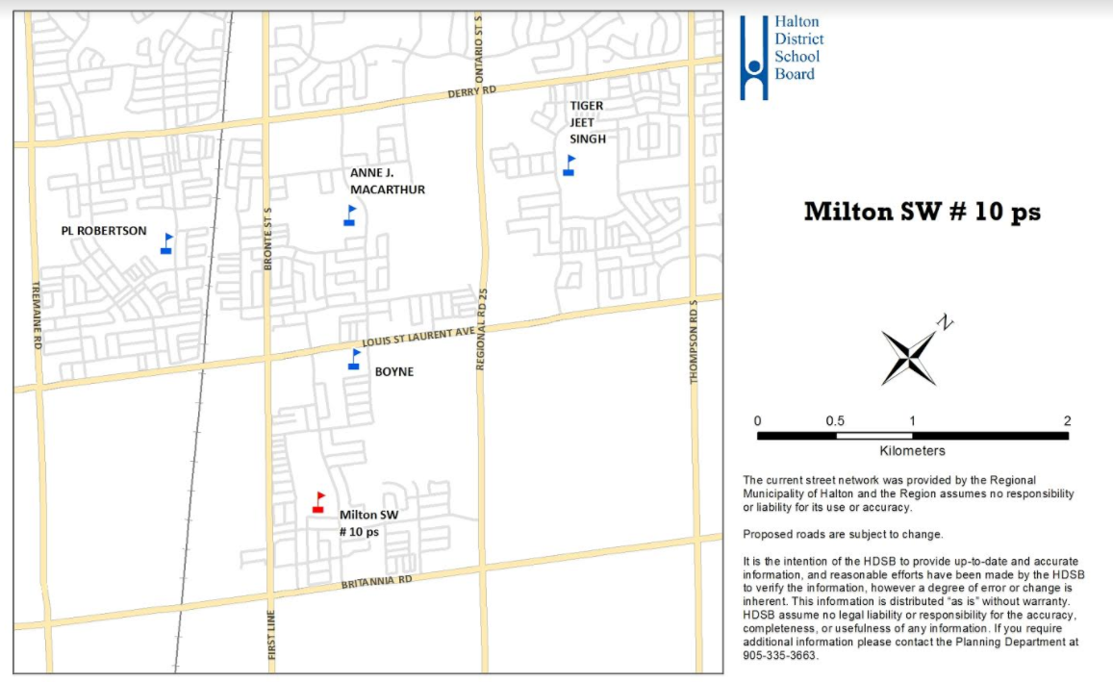
Milton #10 Map

Slide 8
Mandate of Milton #10 BRSC
Determine and communicate which schools are part of the Boundary Review Process
Generate the initial boundary options for consideration by a larger Boundary Review Committee
Consult with the community through Public Information Meetings regarding the Boundary Review Committee’s preferred option(s)
On behalf of the Boundary Review Committee, recommend preferred option(s) to Administrative Council and the Director

Slide 9
Boundary Review Committee Composition
TWO representatives from each school to serve on the Boundary Review Committee (BRC).
PL Robertson PS
Anne J. MacArthur PS
Tiger Jeet Singh PS
Boyne PS
Members of the Boundary Review Steering Committee (BRSC)
‹#›

Slide 10
Mandate of Milton #10 BRC
Work collaboratively to examine the initial boundary options generated by the Steering Committee;
● Provide detailed feedback on the initial options, request modifications or additional options, if required;
● Over the course of a number of working meetings and based upon a set of agreed upon criteria, the committee will arrive at one or more preferred options;
● Preferred option(s) submitted to the Steering Committee to be considered for recommendation to Administrative Council and the Director;
● Parent representatives speak on behalf of all students, regardless of school, program, or grade;
● Staff’s role on the committee is as a resource - to respond to inquiries and to provide committee members with the data and administrative experience required to assess options.

Slide 11
BRC Meetings
Boyne Public School - Library
BRC Meetings at 7 pm
October 24
November 7
November 21
December 12
January 16

Slide 12
Boundary Review Process
STEP 1 and 2
Director submits to Trustees for approval of boundary review. Boundary Review Steering Committee (BRSC) consisting of Board staff and trustees review enrolments, school capacities and programs. Initial boundary scenarios are generated.
STEP 3 and 4
Public announcement of boundary review (Oct. 6th ad Nov. 24th email to schools). Boundary Review Committee (BRC) established, consisting of members of the BRSC and representatives from the affected school communities.
‹#›

Slide 13
STEP 5
Boundary Review Steering Committee develops scenarios, and shares scenarios with the BRC for information and feedback.
Boundary Review Committee reviews scenarios and considers revisions, and makes suggestions to the Boundary Review Steering Committee. After public consultation (Jan. 9th) consider feedback from community for revisions.
BRSC receives feedback from BRC, along with community and make possible revisions to the recommendations.
STEP 6
Boundary Review Steering Committee makes recommendation to the Director. The Superintendent responsible for the boundary review will write a report with the recommended option. Director takes recommended option to Trustees and/or may revise the recommended option prior to taking it to Trustees. Delegations to the Board occur within the timelines for the boundary review process. Board of Trustees make the final decision
STEP 7
The Integration Committee will plan for and implement the positive integration of students and staff affected by the boundary decision and relocation into their new school environment. The appropriate Superintendent of Education would act as the Chair of the Integration Committee
‹#›

Slide 14
Role of Boundary Review Committee
The BRC is established to examine the initial options generated by the Boundary Review Steering Committee and to have the opportunity to give feedback.
Work collaboratively to examine the initial boundary options generated by the Steering Committee;
Provide detailed feedback on the initial options, request modifications or additional options, if required;
Over the course of a number of working meetings and based upon a set of agreed upon criteria, the committee will arrive at one or more preferred options;
Preferred option(s) submitted to the Steering Committee to be considered for recommendation to Administrative Council and the Director;
Final recommendations will be developed through a consensus process;
Parent representatives speak on behalf of all students, regardless of school, program, or grade;
Staff’s role on the committee is as a resource - to respond to inquiries and to provide committee members with the data and administrative experience required to assess options.

Slide 15
The Boundary Review Process (BRC Parent Perspective)
Ian Simpson - School Council Co-Chair - PL Robertson PS
‹#›

Slide 16
Scenarios
The Boundary Review Steering Committee and Boundary Review Committee met regularly to explore and assess all possible boundary scenarios.
Over the course of 4 meetings, the Boundary Review Committee considered 22 scenarios and have recommended 4 scenarios to the steering committee.
All boundary scenarios are available on the Board website (www.hdsb.ca)

Slide 17
Scenarios - 1e
Milton #10 - Opens as a dual track school
FI to be phased in starting with grade 2, September 2018. One grade added per subsequent year
Anne J MacArthur - The English catchment expands west of Bronte Street South to CNR Track, north of the gas pipeline.
The FI catchment to expand south to Louis St. Laurent Blvd between Bronte Street South and Regional Road 25. Current FI students will remain at Anne J. MacArthur PS
Boyne - catchment north of Louis St. Laurent Blvd between the CNR tracks and Bronte Street South, north of the gas pipelines to be re‐directed to AJM PS. All other areas north of Louis St. Laurent Blvd and currently attend Boyne PS remain at Boyne PS. The area bounded by Louis St. Laurent Blvd, CNR tracks, Whitlock Avenue, and Bronte Street South to remain at Boyne PS
Tiger Jeet Singh - New development area(south of Derry, east of Regional 25) redirected to Milton #10
No change to PL Robertson

Slide 18
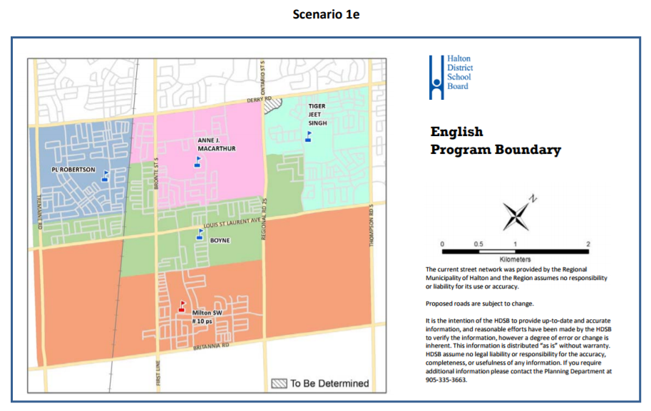
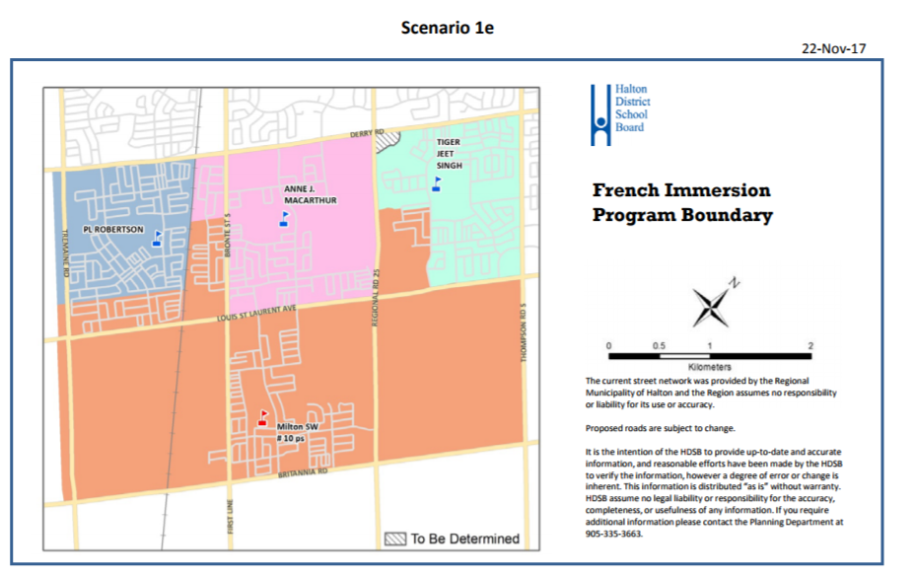

Slide 19
Scenarios - 8c
Milton #10 - Opens as a dual track school
FI to be phased in starting with grade 2, September 2018. One grade added per subsequent year
Anne J MacArthur - The English catchment expands east of Regional Road 25 and north of Louis St. Laurent Blvd.
The FI catchment north of Louis St. Laurent Blvd. to remain at Anne J. MacArthur. Areas south of Louis St. Laurent Blvd to be re-directed to Milton #10. Current FI students will remain at Anne J. MacArthur PS.
Boyne - Boyne PS catchment east Regional Rd 25 and north of Louis St. Laurent Blvd. to be re‐directed to Anne J MacArthur PS. All other areas north of Louis St. Laurent Blvd. and currently attend Boyne PS remain at Boyne PS. The area bounded by Louis St. Laurent Blvd, CNR tracks, Whitlock Avenue, and Bronte Street South to remain at Boyne PS. FI to attend Anne J. MacArthur and Milton #10.
Tiger Jeet Singh - New development area(south of Derry, east of Regional 25) redirected to Milton #10
No change to PL Robertson
Notes:
Current AJM boundary area north of Louis St. Laurent and east of Reg Rd 25 currently has a split grade 8 cohort to Boyne and AJM. This change will unify the that area, ie that community will attend AJM for ENG and FI.

Slide 20
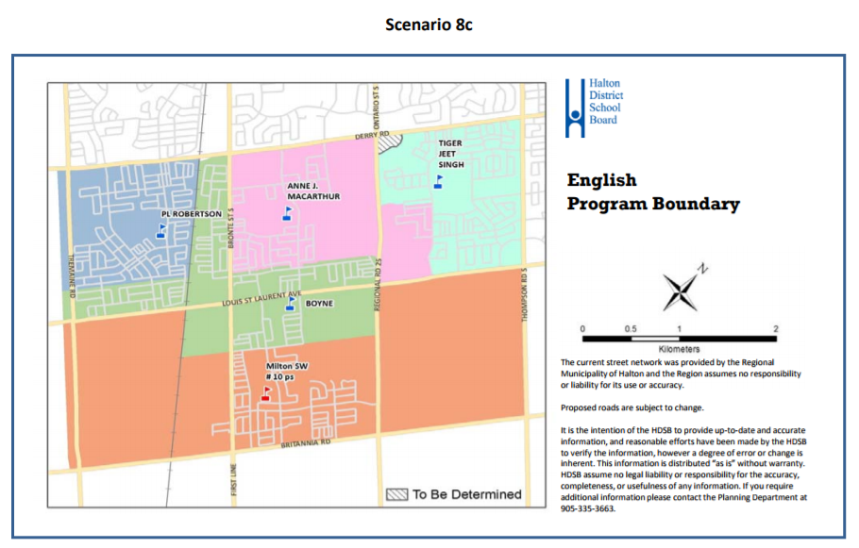
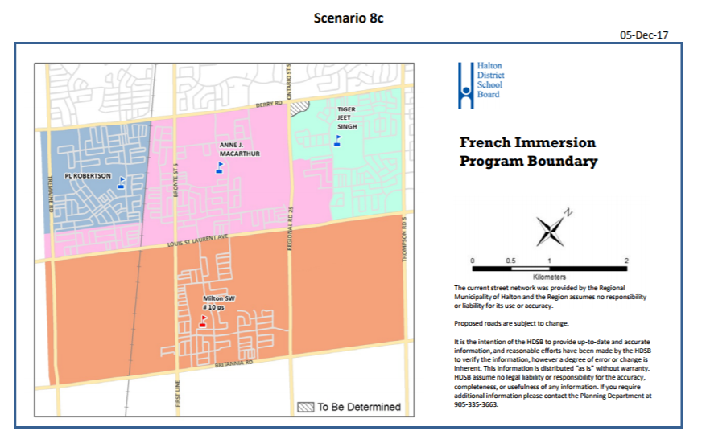

Slide 21
Scenarios -10a
Milton #10 - Opens as a dual track school
FI to be phased in starting with grade 2, September 2018. One grade added per subsequent year
Anne J MacArthur - No change to the English catchment.
FI catchment is bounded by the CNR tracks, Whitlock Avenue, Reg. Road 25, Derry Road and includes the Boyne catchment area east of Reg. Rd 25. Current FI students will remain at Anne J. MacArthur PS.
Boyne - Boyne catchment is bounded by CNR tracks, Whitlock Avenue, Reg, Rd 25, Tiger Jeet Singh PS catchment and Anne J MacArthur PS Eng catchment. The area bounded by Tremaine Rd, P.L. Robertson catchment, CNR tracks, and Louis St. Laurent to be re-directed to Milton #10. FI to attend Anne J. MacArthur PS.
Tiger Jeet Singh - New development area(south of Derry, east of Regional 25) redirected to Milton #10
No change to PL Robertson

Slide 22
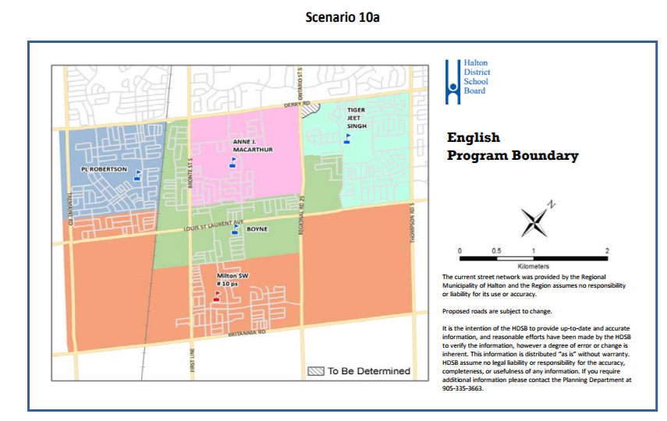
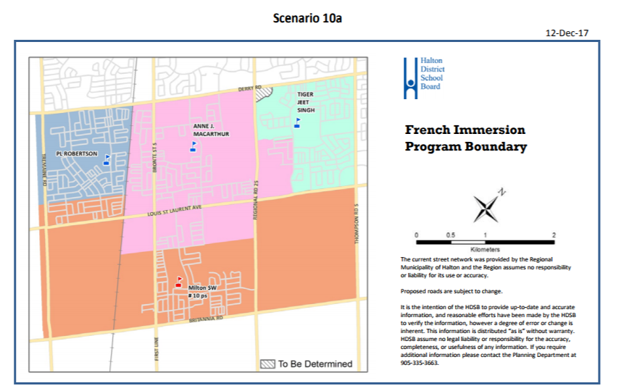

Slide 23
Scenarios - 10c
Milton #10 - Opens as a dual track school
FI to be phased in starting with grade 2, September 2018. One grade added per subsequent year
Anne J MacArthur - The English catchment expands east of Regional Road 25 and north of Louis St. Laurent Blvd.
FI catchment is bounded by the CNR tracks, Whitlock Avenue, Reg. Road 25, Derry Road and includes the Boyne catchment area east of Reg. Rd 25. Current FI students will remain at Anne J. MacArthur PS.
Boyne - Boyne catchment is bounded by CNR tracks, Whitlock Avenue, Reg, Rd 25, Anne J MacArthur PS Eng catchment, Derry Rd. The area bounded by Tremaine Rd, P.L. Robertson catchment, CNR tracks, and Louis St. Laurent to be re-directed to Milton #10. FI to attend Anne J. MacArthur PS.
Tiger Jeet Singh - New development area(south of Derry, east of Regional 25) redirected to Milton #10
No change to PL Robertson

Slide 24
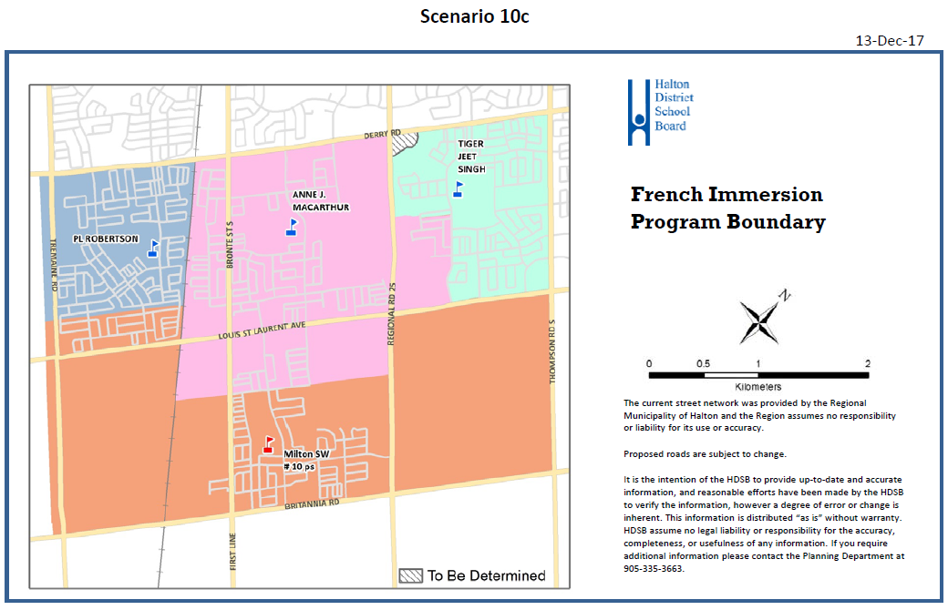

Slide 25
Feedback Process
Personal Public Consultation Feedback Forms are available online at www.hdsb.ca
Deadline for feedback is
Monday, January 15th at noon
Facilitated group feedback opportunities available tonight following this presentation. We will also have laptops available to complete feedback.
Further questions or comments please contact the Planning Department at plan@hdsb.ca
‹#›

Slide 26
Next Steps:
Feedback from the public consultation process will be collated and provided to the Boundary Review Committee for review.
The BRC will use this information when confirming their recommendations to the Boundary Review Steering Committee.
Boundary Review Steering Committee makes recommendations to the Director.
Director takes the recommended option(s) to Trustees and/or may revise the recommended option(s) prior to taking it to Trustees
Trustees will make final decision on the boundary.
‹#›

Slide 27
Timeline for Decision
Recommendation(s) provided to Trustees on
February 7, 2018 and voted on February 21, 2018
Opportunity for the community to delegate at a Board meeting - February 7, 2018 and February 21, 2018
Recommendations will be posted on Board website prior to the Board meetings (www.hdsb.ca)
‹#›

Slide 28
School Groups - Public Feedback
Anne J. MacArthur PS
PL Robertson PS
Tiger Jeet Singh PS
Boyne PS

Slide 29
Thank You!

