Slide 1
Milton #10 Boundary Review Feedback Form Review

Slide 2
General Information
38 attended the public meeting.
42 online responses
Common themes in feedback:
Bussing
Driving/walking past other schools
Number of moves within 5 years
Walkability
Sibling separation (age difference and program)
Portables (at new and current schools)
Comments on Scenarios:
Bussing time is too long.
New families in the (South) attend Milton SW #10 ps.
Limit the amount of major roads crossed. (Concern over crossing Louis Saint Laurent.)
Bring SW pocket by Tiger Jeet Singh to Tiger Jeet Singh instead of a different school.

Slide 3
Scenario Suggestions & Comments
"Those moving into the new homes south of Louis Saint Laurent should attend Milton school #10."
"We would prefer a new scenario which would bring children to Tiger Jeet Singh in our own neighborhood which is only 5 - 8 minutes walk from our home. We won't have to wait for about an hour at the school bus stop and without proper notification, especially during cold winter months."
"Young children south of LSL shouldn’t have to walk by a high school, 2 -4 busy driveways and intersections"
"If my child attends the French program at the new school, her younger sibling should be allowed to attend the new school regardless of the English/French program."

Slide 4
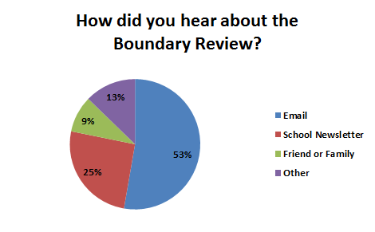
Where Did You Hear About The Review?
29 from email
14 from the school newsletter
7 from other
5 from a friend or family member

Slide 5
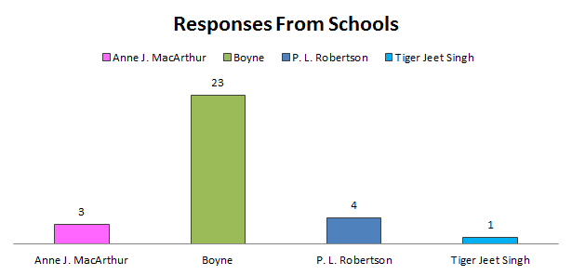
Responses From Schools

Slide 6
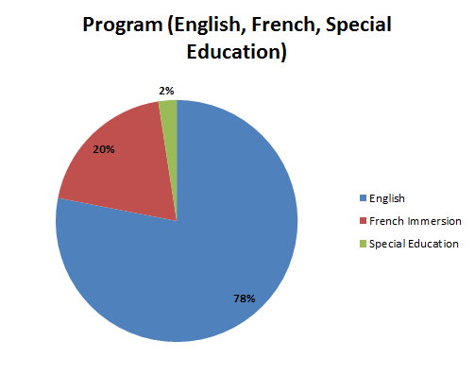
Response By Program
32 English
8 French Immersion
1 Special Education

Slide 7
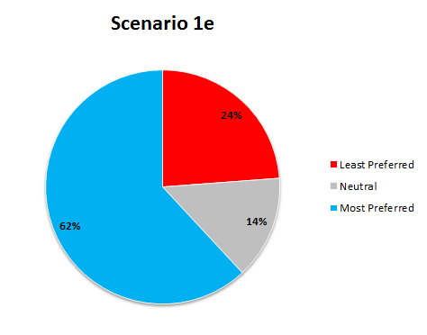
Scenario 1e
26 liked it
6 were neutral
10 disliked it

Slide 8
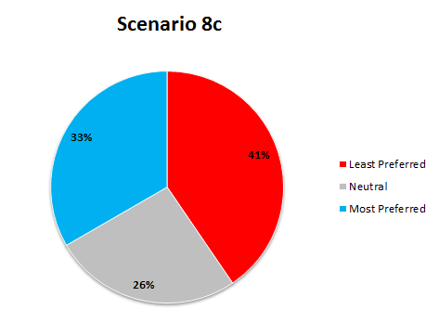
Scenario 8c
14 liked it
11 were neutral
17 disliked it

Slide 9
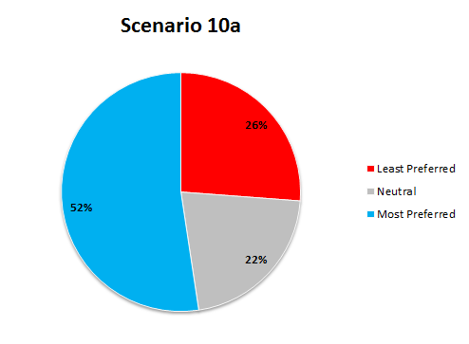
Scenario 10a
22 liked it
9 were neutral
11 disliked it

Slide 10
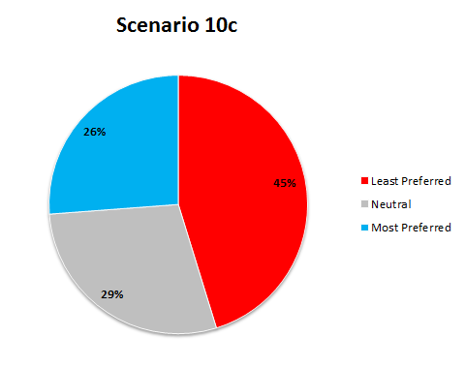
Scenario 10c
11 liked it
12 were neutral
19 disliked it

Slide 12
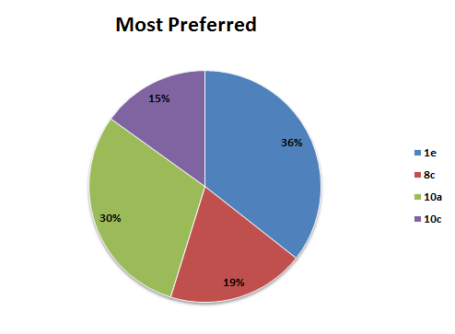
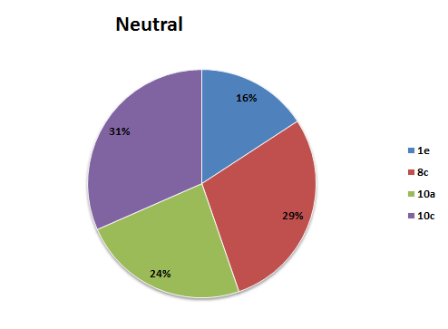
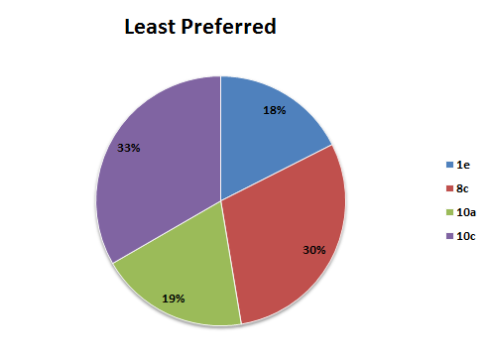
Scenario Summary
Scenario 1e was the favourite.
Scenario 10c was also the most neutral.
Scenario 10c was the most disliked

